Slide 1
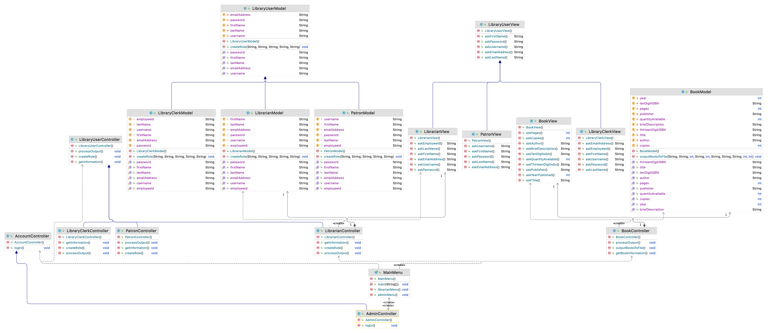
Abstract Class
Inheritance – LibraryUserView inherits from / extends LibraryClerkView
Polymorphism – The method askLastName() in the LibrarianView class overrides the askLastName() method in the LibraryUserView class

